Slide 1
Halloween Search - The Efficient Reference Recommendation Engine
Author : Arka Prava Bandyopadhyay
Date : 21/03/2018
Version : 3.33

Slide 2

Profile
Aspiring Data Scientist
Machine Learning Models,Statistics Data Cleaning, Data Exploration through python (numpy , pandas, matplotlib , scikit-learn etc) (more proficient with python) and R.
Natural Language Processing in python.
Data Visualization skills through Tableau, Power BI, Python (matplotlib ,seaborn ,plotly) and R(ggplot).
Predictive Analysis, Churn Prediction, Recommender System.
Spark, Hadoop, Scala, Hive, Sqoop.
Oracle 11g, Mysql
Bash Scripting
Working knowledge of Amazon Web Service
GitHub Project Link
Arka Prava Bandyopadhyay
Senior Software Engineer
Bangaluru, PSN
Contact : +91 8961497680
www.referencia.com
© 2017 Capgemini. All rights reserved.
2

Slide 3


DISCLAIMER : NOT cutting-edge AI !!!
After 60 years of debate between 2 programming paradigm, neural networks decisively defeated the logic based programming paradigm with the advent of powerful GPUs.
1 . Logic Based(If-Else)
2. Neural Network Based/Artificial Intelligence
Our model uses Logic based approach due to lack of data. I will discuss later how we can make this model cutting edge by injecting artificial intelligence in future scope.

Slide 4



Why this competition was basically a fist fight or hand to hand combat without any sophesticated weapons?
Advanced usage of NLTK and application of parts of speech tagging, chunking, chinking etc.
Topic Modelling(LDA & NMF)
I tried my best to use topic modelling as I was fascinated to see its usefulness from the news article segmentation. But in this case as most of the documents contains similar kind of words, topic modelling wasn’t particularly useful. Though it segmented MDM,SAP, Big Data etc related ppts correctly, it wasn’t much of use though.
Well, as the text of the ppts were pretty short and followed a certain issue solution benefit pattern, I was skeptical how good these result these methods will produce. In my opinion these methods will be fantastic to use while extracting relevant results from the novels or essays. In this case not so useful.
Similarity Check with TF-IDF and Cosine Similarity
That leaves us with similarity matching with cosine similarity. It is working fantastically and core of the entire model. But as it was taught in the 3rd training session, it becomes like the hands of ours, everyone has it but whoever can use it better will win this fist fight or hand to hand combat.
Notes:
Fixar a posicao do titulo – sempre do lado esquerdo.
Sempre que tiver muito texto o coluna deve sempre ser “ narrowed” , se nao fica dificil de ler. Colocar paragrafos no texto.
Linha vertical deve ser mais fina e as pontas NUNCA devem ser arredondadas.

Slide 5
What is TF-IDF ?
TF-IDF = Term Frequency * Inverse Document Frequency
Term Frequency = Relative frequency of a term in a given document
Inverse Document Frequency = log of the total number of documents divided by the number of documents that contain the term
We compute TF-IDF value for all the words in a document.
Notes:
O Box atras do texto desnecessario. Deixar o layout mais simples.

Slide 6
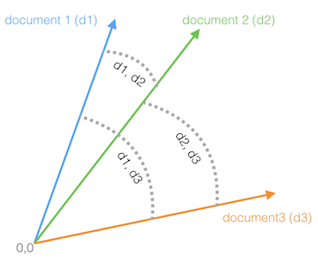
What is cosine similarity?
Even though we have a table of TF-IDF values for every term in every document, in order to make any use of it we need a way of comparing documents. In other words: of determining the distance between the frequency values (columns) for any of the documents in the rows. In effect, we want a way of expressing how different two rows (documents) are.
We can do this by converting our TF-IDF values from each document into geometric space. Imagine each term frequency (as TF-IDF) as a point on a Cartesian graph and a value that expresses the aggregate of these points. Each document could thus be expressed as a vector, or a line with a certain magnitude (length) and angle from the origin (0, 0).
Because the length of the line (the total magnitude of the total TF-IDF values) would be sensitive to the length of the document, we can't simply compare the lines for each document, but we can compare the angle between the documents – that's the essence of cosine similarity.
- cosine distance between document 1 and document 2 (d1, d2)
- cosine distance between document 2 and document 3 (d2, d3)
- cosine distance between document 1 and document 3 (d1, d3)

Slide 7
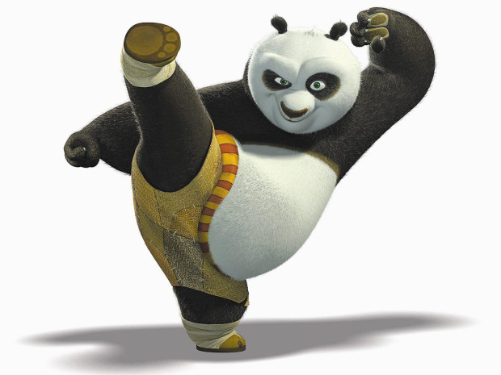
Training Kung-Fu to the model/The edge over other models
Sector Match
01
Name Match
02
Country Match
03
Technology Match
04
05
Cosine Similarity Match

Slide 8
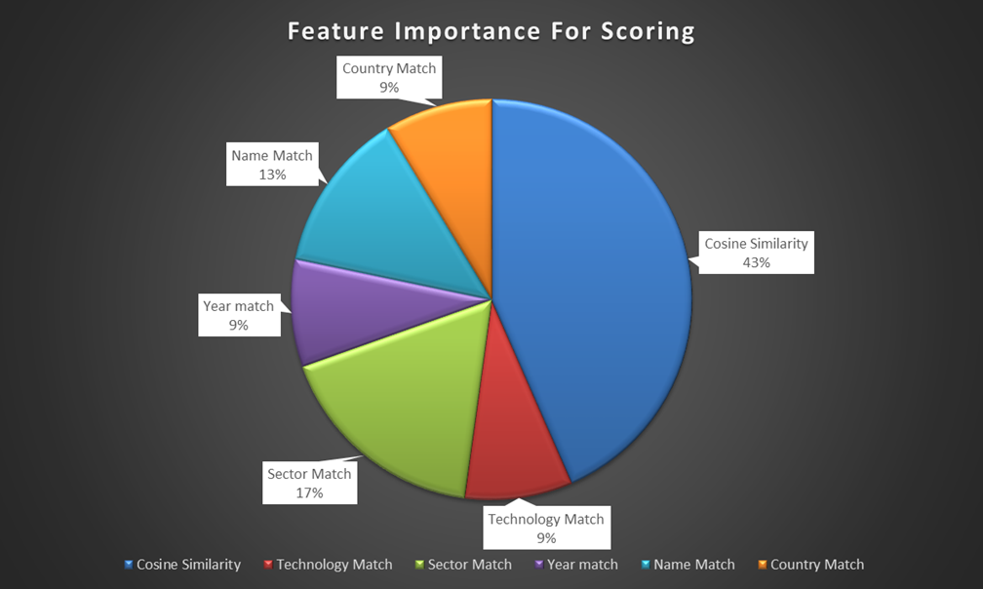
Training Kung-Fu to the model/The edge over other models
Main Score :
df1.loc[i,('score')] = df1.loc[i,('cos_sim')]*1 + df1.loc[i,('Match_tech')]*.20 +df1.loc[i,('query_sector')] * 0.40 +df1.loc[i,('query_year')] * 0.20 + df1.loc[i,('name_match')]*0.30 + df1.loc[i,('query_country')]*0.20
And top 4 items with highest cosine similarity will be compensated with some boost in case they don’t explicitly have the other features due to the data being dirty and unstructured.
df1.loc[i,('score')] = df1.loc[i,('score')] + df1.loc[i,('cos_sim')]/df1.loc[i,('score')]

Slide 9
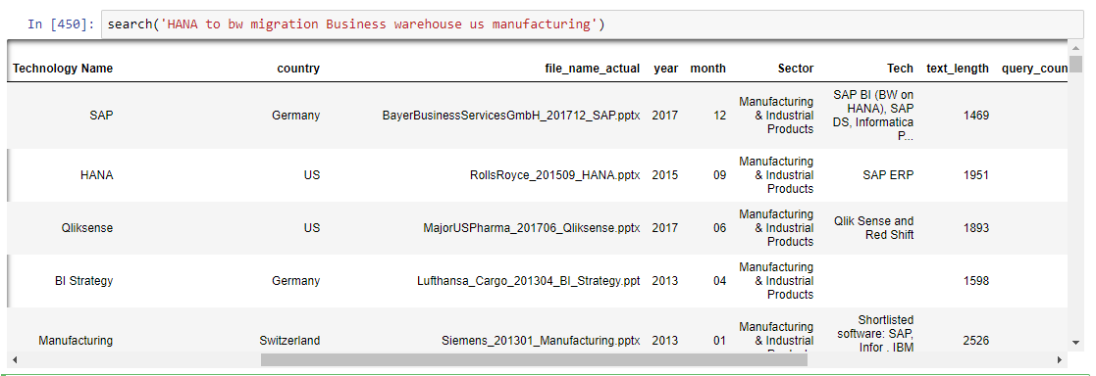
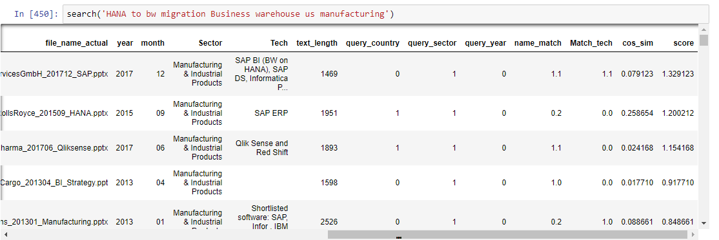
Search in ACTION :

Slide 10

How to get the optimal result/Future Scope ??
Deploy this good enough model to the Capgemini employees
Let them search and click on their preferred ppts.
Gather lots of labeled data.
Use supervised machine learning methods to let the model decide the feature importance for itself.
Use clustering techniques to segment users by their clicking behaviors , country , sectors and positions.
Recommend different items based on the cluster of the users.

Slide 11
Challenges Faced
Extracting data from the ppts
01
Resolved this problem by writing and executing a bash script from python environment itself to convert the ppts to pptx and extract xmls from pptx and extract text from the xml.
Coming to realization it’s a Hand to Hand combat problem NOT nuclear war
02
Okay, when someone hears about the data science competition, the first thing comes to mind is the nuclear weapons, ensemble methods, boosting , xgboost etc. As it was a unsupervised learning problem with unlabeled data so all nuclear weapons goes out of the picture at the very first moment. Then for this project it was difficult to accept that parts of speech tagging, chinking and chunking, matching similarity with words with word2vec won’t be of much use. But I learnt my lessons quickly and focused on cosine similarity and other extracted features to give most accurate recommendation results.
© 2017 Capgemini. All rights reserved.
11
Notes:
Este slide eles acham que esta muito apertado.
Mudar o estilo do texto do lado esquerdo para diferencia-lo do texto do lado direito. Menos texto e mais impactante “short introduction”. Coloccar este texto do lado esquerdo da mesma cor da forma e o fundo do dlide claro.

